Slide 1
2020 Vision Shining in the City # 2
“Let us begin this good work!”
Nehemiah 2:1-20

Slide 2
The “spirit tree” at Cape Reinga
The remnant: God’s chosen people are still clinging to life
Notes:
In January, we visited Cape Reinga. There is a point from which the spirits of the dead are believed to depart our land for the afterlife. At this point, a lone Pohutakawa can be seen hanging off the cliff. There it is, assaulted by wind and salt, tenaciously clinging to life year after year . This hardy tree reminds me of the plucky nation of Israel towards the end of the Exile.
God’s chosen people have been virtually erased as a people by a succession of devastating military defeats, but like that tree at Cape Reinga, a remnant clings to life still.

Slide 3
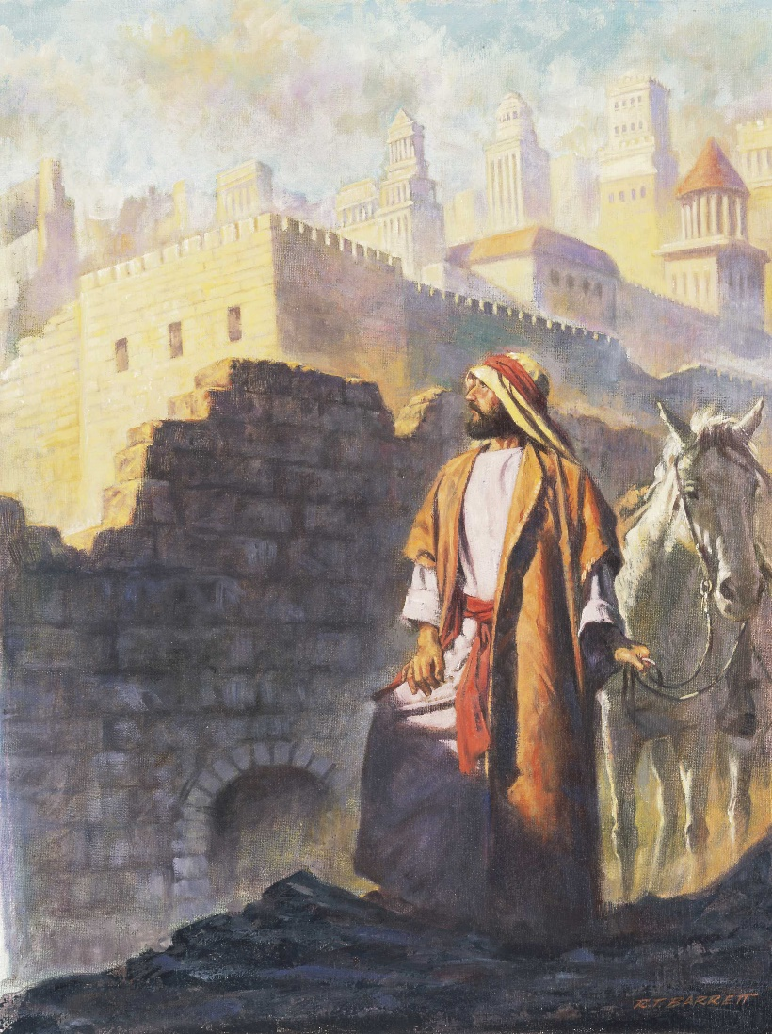
Nehemiah’s Burden
“Those who survived the exile and are back in the province are in great trouble and disgrace. The wall of Jerusalem is broken down, and its gates have been burned with fire.” (1:3)
Nehemiah’s response
He was cup-bearer to the king - a position of absolute trust
The king notices that he seems out of sorts
Notes:
Today we want to dip into their story through the eyes of Nehemiah. For an exile, Nehemiah was doing pretty well. He was in a privileged position in Susa (Persia) – he was rubbing shoulders with the big man himself, King Artaxerxes, who was King of the Persian Empire from 404 to 358BC.
At this time, a remnant have returned the land. A report arrives that those they are not doing well.
“Those who …
How can they have a hope of defending themselves against their enemies, let alone fulfil God’s call on their lives?
Nehemiah’s response: Nehemiah could have sent the people a cheque and carried on with his important duties, but he is in deep grief. He prays a passionate prayer for God’s mercy and continues to be very upset about the situation.
Nehemiah was cup-bearer to the king. He didn’t serve the tea and coffee. He tasted the king’s cup before the king drank it. It was a position of absolute trust. The king trusted him with his life. Nehemiah earned this position over years of proving himself trustworthy.
When the king notices that he seems out of sorts, we read these words:

Slide 4
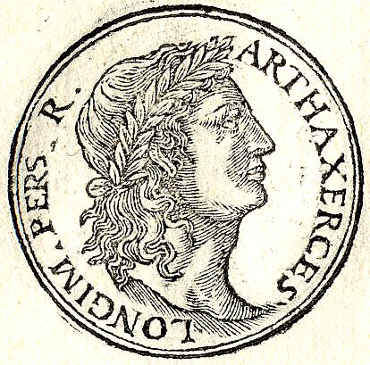
Nehemiah’s Request
“I was very much afraid. ³ but I said to the king, ‘May the king live for ever! Why should my face not look sad when the city where my ancestors are buried lies in ruins, and its gates have been destroyed by fire?’ ⁴ The king said to me, ‘What is it you want?’ Then I prayed to the God of heaven.” (2:2-4)
Notice his reply in verses 7-8 - He seems to know what he’s talking about!
Notes:
“I was …”
Notice his reply. He’s ready. He’s specific. He’s thought it through. He comes across as a good investment, because he seems to know what he’s talking about. Vague requests get vague responses. What do you need? I need X, Y and Z. Yes. It’s bold. Yes, it’s cheeky. But as Jesus said, “you have not because you ask not.”

Slide 5
The principle for us
Vague goals and vague proposals produce vague responses!
Two traps we often fall into in regards to money in the church
Request granted!
Notes:
In my experience, people of means are willing to partner with people who know what their goal is and what they need. Vague goals and vague proposals elicit vague responses! [Share World Vision’s Chosen campaign from 6/2/20 concert]
By the way, there are two traps …
We can talk too much about money – a 20-minute offering sermon is not uncommon in some churches. Those churches have big visions which require a lot of funding, but if they are not careful, they can distort the message of what they’re actually all about.
The second trap is to talk too little about money. As if it’s something embarrassing. Elders and pastors of such churches may grumble that people aren’t giving enough, but often they haven’t been asked to – or the need is so vague – well, you get the picture.
Request granted! So N gets want he wants plus an extended leave of absence and travels to Jerusalem. This was no short trip. The journey alone would have taken 4 months!

Slide 6
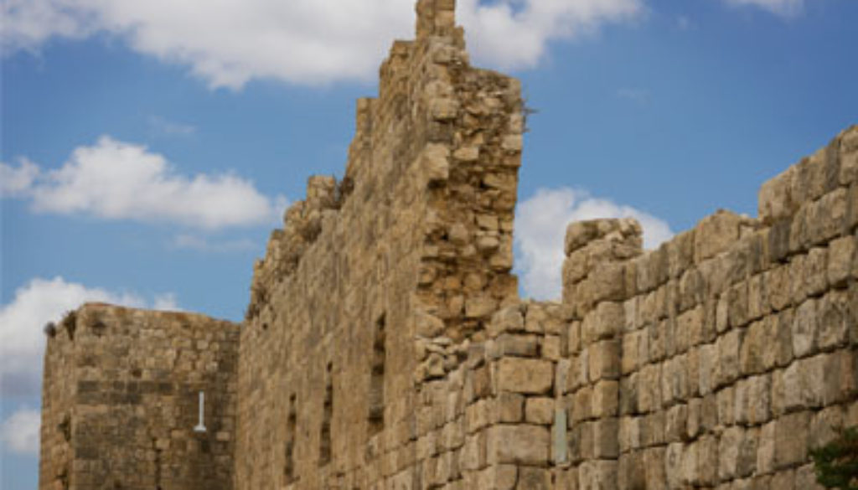
Nehemiah’s Arrival
¹² I set out during the night with a few others. I had not told anyone what my God had put in my heart to do for Jerusalem.
Nehemiah did his homework
Notes:
What did N do first?
Verse 12: I set out …
Before he invited the people to join him in tackling this project, N did his homework. You can tell from this chapter and the one that follows that he was meticulous. He defined the problem before he articulated the solution. So the vision he imparted was not some pie-in-the-sky fantasy, but it was rooted in the actual needs of the city.

Slide 7
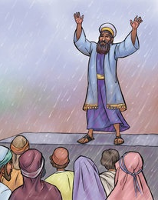
Nehemiah’s “Pitch”
¹⁷ Then I said to them, ‘You see the trouble we are in: Jerusalem lies in ruins, and its gates have been burned with fire. Come, let us rebuild the wall of Jerusalem, and we will no longer be in disgrace.’ ¹⁸ I also told them about the gracious hand of my God on me and what the king had said to me. They replied, ‘Let us start rebuilding.’ So they began this good work.
How does Nehemiah inspire the people here?
Vision: “A description of the ideal future”
Notes:
Verses 17-18: ¹⁷ Then I said …
How does Nehemiah inspire the people here? [Ask]
He told the story. He shared the problem. He invited them to be involved in the solution. He gave the progress to date. Then came the knockout punch: God is in this! Do you want to be part of what He is doing?
A vision can be described as … Perhaps the most communication of vision was this one:

